Slide 1
Transportation, Assignment and Transshipment Problems

Slide 2
Formulating Transportation Problems
The transportation problem seeks to minimize the total shipping costs of transporting goods from m origins (each with a supply s_{i}) to n destinations (each with a demand d_{j}), when the unit shipping cost from an origin, i, to a destination, j, is c_{ij}.

Slide 3
Example;
Powerco has three electric power plants that supply the needs of four cities.
Each power plant can supply the following numbers of kilowatt-hours (kwh) of electricity: plant 1— 35 million; plant 2—50 million; plant 3—40 million (see Table).
The peak power demands in these cities, which occur at the same time (2 P.M.), are as follows (in kwh): city 1—45 million; city 2—20 million; city 3—30 million; city 4—30 million.
The costs of sending 1 million kwh of electricity from plant to city depend on the distance the electricity must travel.
Formulate an LP to minimize the cost of meeting each city’s peak power demand.

Slide 4
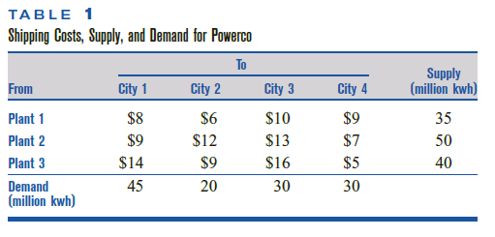
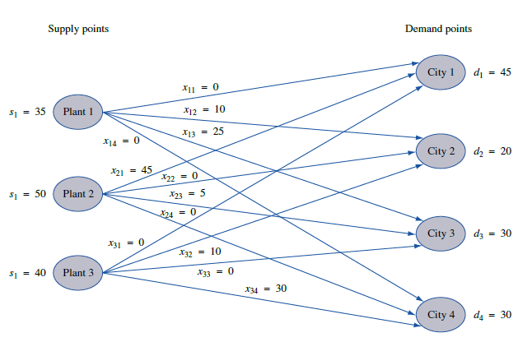

Slide 5

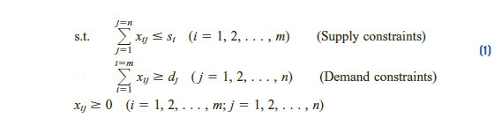

General Description of a Transportation problem
If a problem has the constraints given in (1) and is a maximization problem, then it is still a transportation problem
If total supply equals total demand, and the problem is said to be a balanced transportation problem.

Slide 6
Balancing a Transportation Problem If Total Supply Exceeds Total Demand
If total supply exceeds total demand, we can balance a transportation problem by creating a dummy demand point that has a demand equal to the amount of excess supply.
Because shipments to the dummy demand point are not real shipments, they are assigned a cost of zero.
Shipments to the dummy demand point indicate unused supply capacity.

Slide 7
A transportation problem is specified by the supply, the demand, and the shipping costs, so the relevant data can be summarized in a transportation tableau.
The square, or cell, in row i and column j of a transportation tableau corresponds to the variable xij.
If xij is a basic variable, its value is placed in the lower left-hand corner of the ijth cell of the tableau.

Slide 8
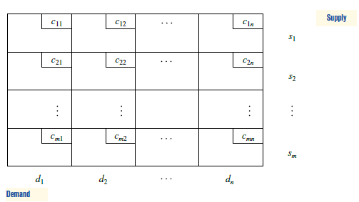
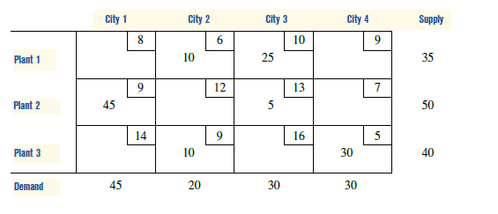


Slide 9
Balancing a Transportation Problem If Total Supply Is Less Than Total Demand
If a transportation problem has a total supply that is strictly less than total demand, then the problem has no feasible solution.
When total supply is less than total demand, it is sometimes desirable to allow the possibility of leaving some demand unmet.
In such a situation, a penalty is often associated with unmet demand.

Slide 10
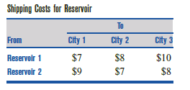
Handling Shortages
Two reservoirs are available to supply the water needs of three cities.
Each reservoir can supply up to 50 million gallons of water per day. Each city would like to receive 40 million gallons per day.
For each million gallons per day of unmet demand, there is a penalty.
At city 1, the penalty is $20; at city 2, the penalty is $22; and at city 3, the penalty is $23.
The cost of transporting 1 million gallons of water from each reservoir to each city is shown in Table.
Formulate a balanced transportation problem that can be used to minimize the sum of shortage and transport costs.

Slide 11
Modeling Inventory Problems as Transportation Problems
Sailco Corporation must determine how many sailboats should be produced during each of the next four quarters (one quarter is three months). Demand is as follows: first quarter, 40 sailboats; second quarter, 60 sailboats; third quarter, 75 sailboats; fourth quarter, 25 sailboats.
Sailco must meet demand on time. At the beginning of the first quarter, Sailco has an inventory of 10 sailboats.
At the beginning of each quarter, Sailco must decide how many sailboats should be produced during the current quarter.
For simplicity, we assume that sailboats manufactured during a quarter can not be used to meet demand for the earlier quarters.
During each quarter, Sailco can produce up to 40 sailboats at a cost of $400 per sailboat.
By having employees work overtime during a quarter, Sailco can produce additional sailboats at a cost of $450 per sailboat.
At the end of each quarter (after production has occurred and the current quarter’s demand has been satisfied), a carrying or holding cost of $20 per sailboat is incurred.
Formulate a balanced transportation problem to minimize the sum of production and inventory costs during the next four quarters.

Slide 12
Example
A shoe company forecasts the following demands during the next six months: month 1—200; month 2—260; month 3—240; month 4—340; month 5—190; month 6—150.
It costs $7 to produce a pair of shoes with regular-time labor (RT) and $11 with overtime labor (OT).
During each month, regular production is limited to 200 pairs of shoes, and overtime production is limited to 100 pairs.
It costs $1 per month to hold a pair of shoes in inventory.
Formulate a balanced transportation problem to minimize the total cost of meeting the next six months of demand on time.

Slide 13
Example
The U.S. government is auctioning off oil leases at two sites: 1 and 2.
At each site, 100,000 acres of land are to be auctioned.
Cliff Ewing, Blake Barnes, and Alexis Pickens are bidding for the oil.
Government rules state that no bidder can receive more than 40% of the land being auctioned.
Cliff has bid $1,000/acre for site 1 land and $2,000/acre for site 2 land.
Blake has bid $900/acre for site 1 land and $2,200/acre for site 2 land.
Alexis has bid $1,100/acre for site 1 land and $1,900/acre for site 2 land.
Formulate a balanced transportation model to maximize the government’s revenue.

Slide 14
Paperco recycles newsprint, uncoated paper, and coated paper into recycled newsprint, recycled uncoated paper, and recycled coated paper.
Recycled newsprint can be produced by processing newsprint or uncoated paper.
Recycled coated paper can be produced by recycling any type of paper.
Recycled uncoated paper can be produced by processing uncoated paper or coated paper.
The process used to produce recycled newsprint removes 20% of the input’s pulp, leaving 80% of the input’s pulp for recycled paper.
The process used to produce recycled coated paper removes 10% of the input’s pulp.
The process used to produce recycled uncoated paper removes 15% of the input’s pulp.
The purchasing costs, processing costs, and availability of each type of paper are shown in Table.
To meet demand Paperco must produce at least 250 tons of recycled newsprint pulp, at least 300 tons of recycled uncoated paper pulp, and at least 150 tons of recycled coated paper pulp.
Formulate a balanced transportation problem that can be used to minimize the cost of meeting Paperco’s demands.

Slide 15
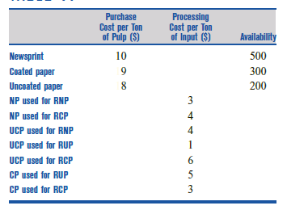

Slide 16
Finding Basic Feasible Solutions for Transportation Problems
Consider a balanced transportation problem with m supply points and n demand points.
From (2), we see that such a problem contains m +n equality constraints.
The special structure of a balanced transportation problem makes it easy for us to find a bfs.
Before describing three methods commonly used to find a bfs to a balanced transportation problem, we need to make the following important observation.
If a set of values for the xij’s satisfies all but one of the constraints of a balanced transportation problem, then the values for the xij’s will automatically satisfy the other constraint.

Slide 17
For example, in the Powerco problem, suppose a set of values for the xij’s is known to satisfy all the constraints with the exception of the first supply constraint.
Then this set of xij’s must supply d1 + d2 + d3 +d4 = 125 million kwh to cities 1–4 and supply s2 + s3
125 - s1 = 90 million kwh from plants 2 and 3.
Thus, plant 1 must supply 125 - (125 - s1) =35 million kwh, so the xij’s must also satisfy the first supply constraint.

Slide 18
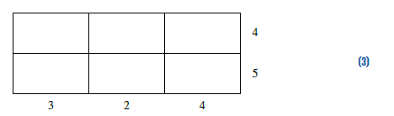
When we solve a balanced transportation problem, we may omit from consideration any one of the problem’s constraints and solve an
LP having m + n - 1 constraints. We (arbitrarily) assume that the first supply constraint is omitted from consideration.
In trying to find a bfs to the remaining m + n - 1 constraints, you might think that
any collection of m + n - 1 variables would yield a basic solution.
Unfortunately, this is not the case.
For example, consider (3), a balanced transportation problem. (We omit the costs because they are not needed to find a bfs.)

Slide 19
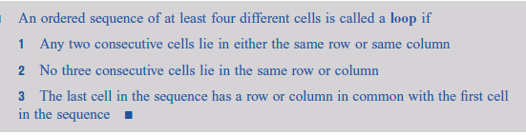
The simple concept of a loop may be used to determine whether an arbitrary set of m + n - 1 variables yields a basic solution to a balanced transportation problem.
The loop may be thought of as a closed path

Slide 20
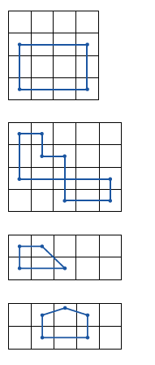
Examples

Slide 21

Theorem 1 follows from the fact that a set of m + n - 1 cells contains no loop if and only if the m + n - 1 columns corresponding to these cells are linearly independent.

Slide 22
Methods to find a Bfs for balanced Transportation Problem
Northwest corner method
Minimum-cost method
Vogel’s method

Slide 23
Northwest Corner Method for Finding a Basic Feasible Solution
To find a bfs by the northwest corner method, we begin in the upper left (or northwest) corner of the transportation tableau and set x11 as large as possible.
Clearly, x11 can be no larger than the smaller of s1 and d1.
If x11 = s1, cross out the first row of the transportation tableau; this indicates that no more basic variables will come from row 1.
Also change d1 to d1 - s1.
If x11 = d1, cross out the first column of the transportation tableau; this indicates that no more basic variables will come from column 1.
Also change s1 to s1 - d1.
If x11 = s1 = d1, cross out either row 1 or column 1 (but not both). If you cross out row 1, change d1 to 0; if you cross out column 1, change s1 to 0.
Continue applying this procedure to the most northwest cell in the tableau that does not lie in a crossed-out row or column.
Eventually, you will come to a point where there is only one cell that can be assigned a value.
Assign this cell a value equal to its row or column demand, and cross out both the cell’s row and column.
A basic feasible solution has now been obtained.

Slide 24
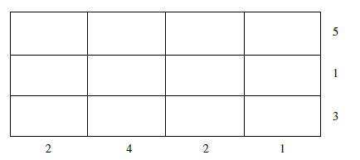
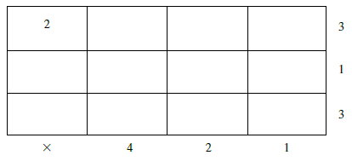
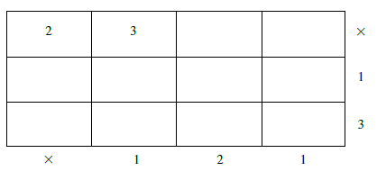
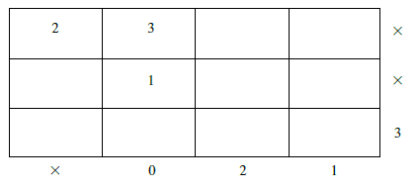
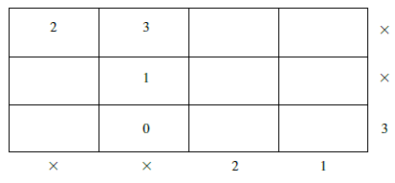
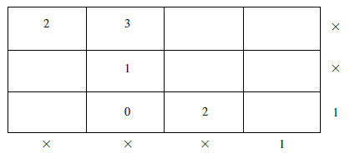
Example

Slide 25
Minimum-Cost Method for Finding a Basic Feasible Solution
The northwest corner method does not utilize shipping costs, so it can yield an initial bfs that has a very high shipping cost.
The minimum-cost method uses the shipping costs in an effort to produce a bfs that has a lower total cost.
To begin the minimum-cost method, find the variable with the smallest shipping cost (call it xij).
Then assign xij its largest possible value, min{si, dj}. As in the northwest corner method, cross out row i or column j and reduce the supply or demand of the noncrossed-out row or column by the value of xij.
Then choose from the cells that do not lie in a crossed-out row or column the cell with the minimum shipping cost and repeat the procedure.
Continue until there is only one cell that can be chosen.
In this case, cross out both the cell’s row and column.
Remember that (with the exception of the last variable) if a variable satisfies both a supply and demand constraint, only cross out a row or column, not both.

Slide 26
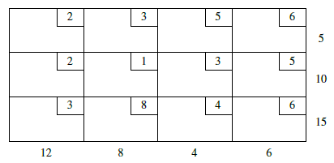
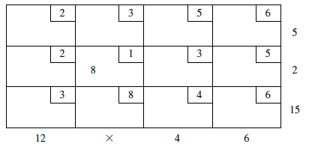
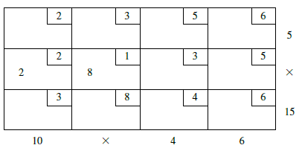
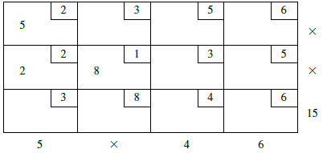
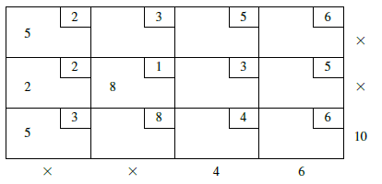
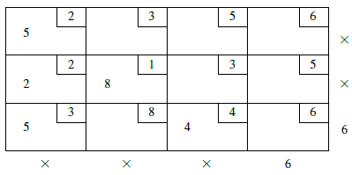
Example

Slide 27
Vogel’s Method for Finding a Basic Feasible Solution
Begin by computing for each row (and column) a “penalty” equal to the difference between the two smallest costs in the row (column).
Next find the row or column with the largest penalty.
Choose as the first basic variable the variable in this row or column that has the smallest shipping cost.
As described in the northwest corner and minimum-cost methods, make this variable as large as possible, cross out a row or column, and change the supply or demand associated with the basic variable.
Now recompute new penalties (using only cells that do not lie in a crossed-out row or column), and repeat the procedure until only one uncrossed cell remains.
Set this variable equal to the supply or demand associated with the variable, and cross out the variable’s row and column.
A bfs has now been obtained.

Slide 28
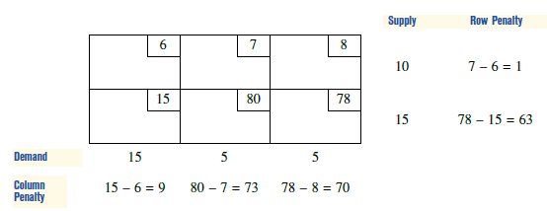
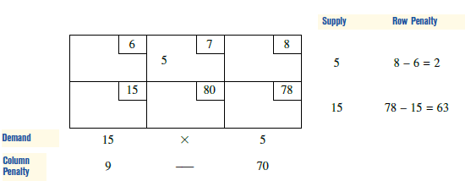
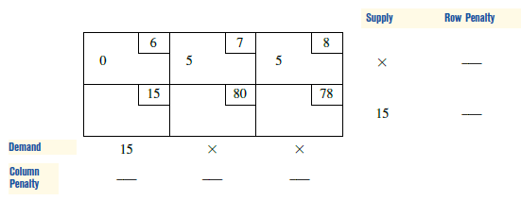
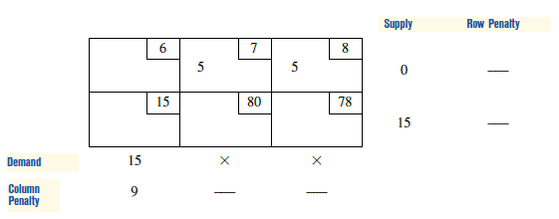
Example

